Slide 1
Assessing Financial Failure in Southwest Wisconsin Municipalities
2023 Data Science Capstone Team

Slide 2
Introduction
Collaboration with SWWRPC
Our Goal: Understand and predict financial failure in Southwest Wisconsin (Grant, Green, Iowa, Lafayette, Richland)
Datasets from Wisconsin Department of Revenue and ARPA funds (American Rescue Plan Act – COVID rescue funds)
Removed variables that were not representative of self-sufficiency.

Slide 3
Defining Failure
What does it mean for a municipality to be vulnerable to failure?
Expenses exceed revenue
Forces municipalities into one of the following:
Take on substantial debt
Bailed out by higher government
Worst Case Scenario: Dissolution

Slide 4
Improving Failure Metric
Expenses exceeding revenue is a bit too sensitive.
Municipalities are expected to keep a reserve fund.
Use an estimated fund
25% previous years' expenses
Failure now defined as expenses exceeding revenue by a magnitude over the estimated fund.
Failure: expenses – revenue > 25% previous years' expenses
New metric titled Vulnerability

Slide 5
Total Revenue and Total Expenses
The total revenue and total expenses of the municipalities.
Total Revenue includes the following: All Other State Aids, Fines Forfeitures and Penalties, General Property Taxes, In Lieu of Taxes, Interest Income, Intergovernmental Charges for Services, Licenses and Permits, Other Local Government Aids, Other Revenues, Other Taxes, Public Charges for Services, Special Assessments, State Highway Aids, State Shared Revenues, and Tax Increments.
Total Expenses includes the following: All Other Expenditures, Ambulances, Conservation and Development, Culture and Education, Fire, General Government, Health and Human Resources, Highway Maintenance and Administration, Law Enforcement, Other Financing Uses, Other Public Safety, Other Sanitation, Other Transportation, Parks and Recreation, Road Related Facilities, Solid Waste Collection and Disposal.

Slide 6
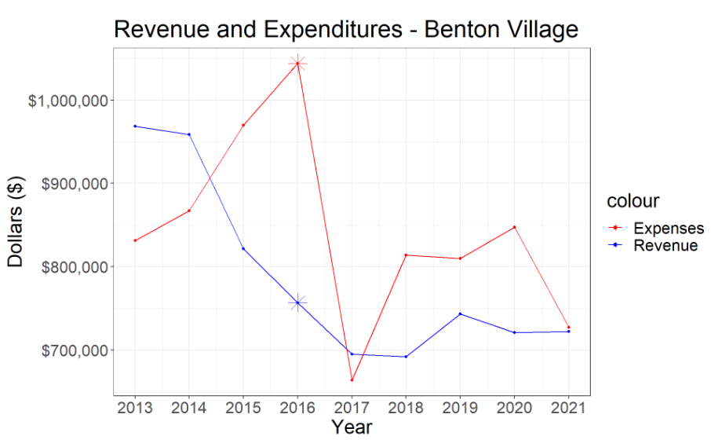
Individual Report - Benton Village
Revenue and Expenses graph.
Visualize year to year profits.

Slide 7
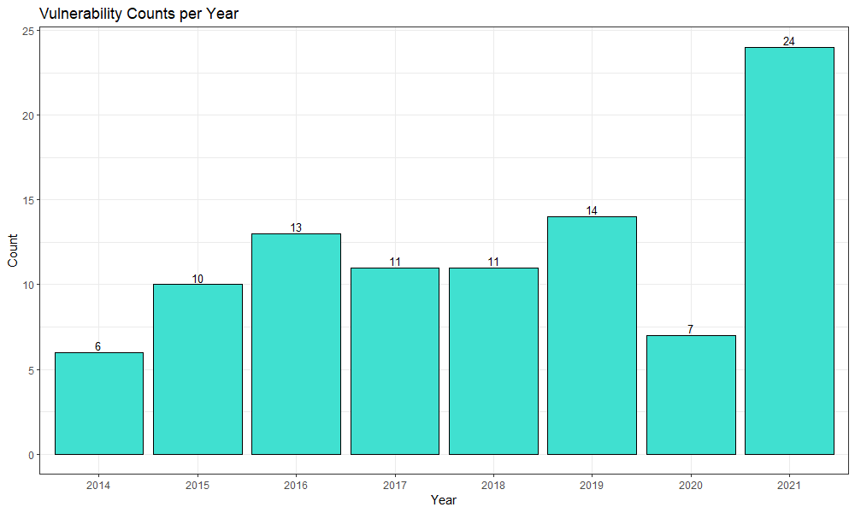
Vulnerability Count by Year
Number of municipalities that are vulnerable to failure by year.
Out of 148 municipalities.
Stark increase in 2021.

Slide 8
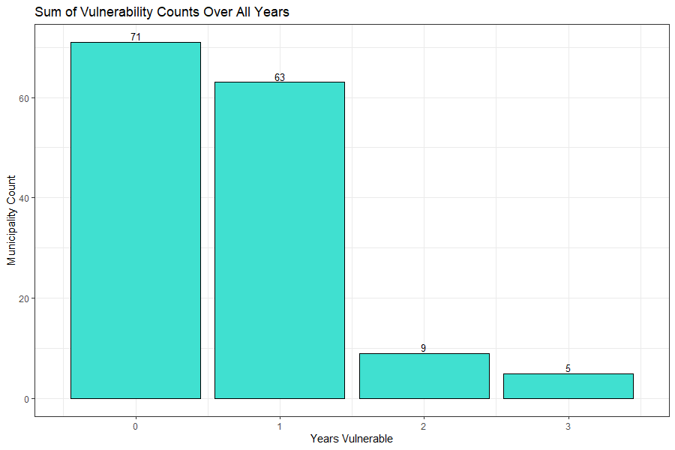
Cumulative Vulnerability Counts
Number of years of vulnerability for each municipality.
Over span of 9 years.
Max is 2, min is 0.
Most years of vulnerability are single year incidents.

Slide 9
List of Vulnerable Municipalities
Municipality – Type | Years Vulnerable
Darlington – C | 1
Dodgeville – C | 1
Fennimore – C | 1
Dickeyville – V | 3
Yuba – V | 3
Brooklyn – V | 2
Bloom – T | 3
Monroe – T | 3
Seymour – T | 3
Cities are less likely to fall into a vulnerable state
Majority of vulnerable municipalities are townships

Slide 10
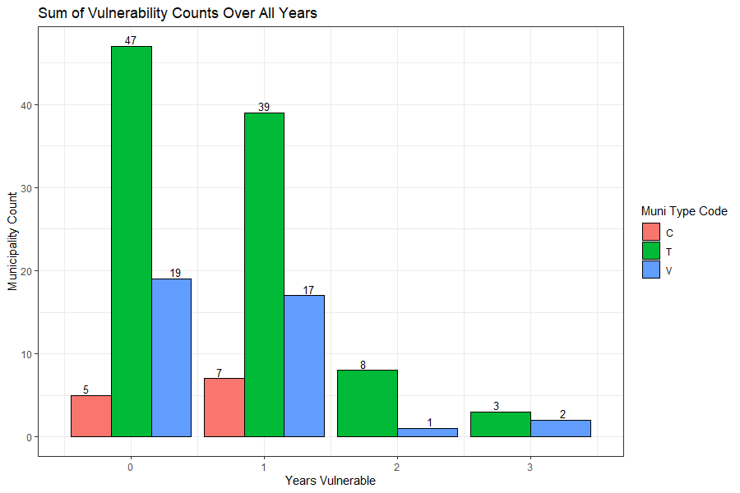

Slide 11
Individual Report- Breakout Graphs
Each municipality has its own unique circumstances.
A deeper look is required.
All contributions to total revenue and expenses.
Shows potential causes for vulnerability to failure.

Slide 12
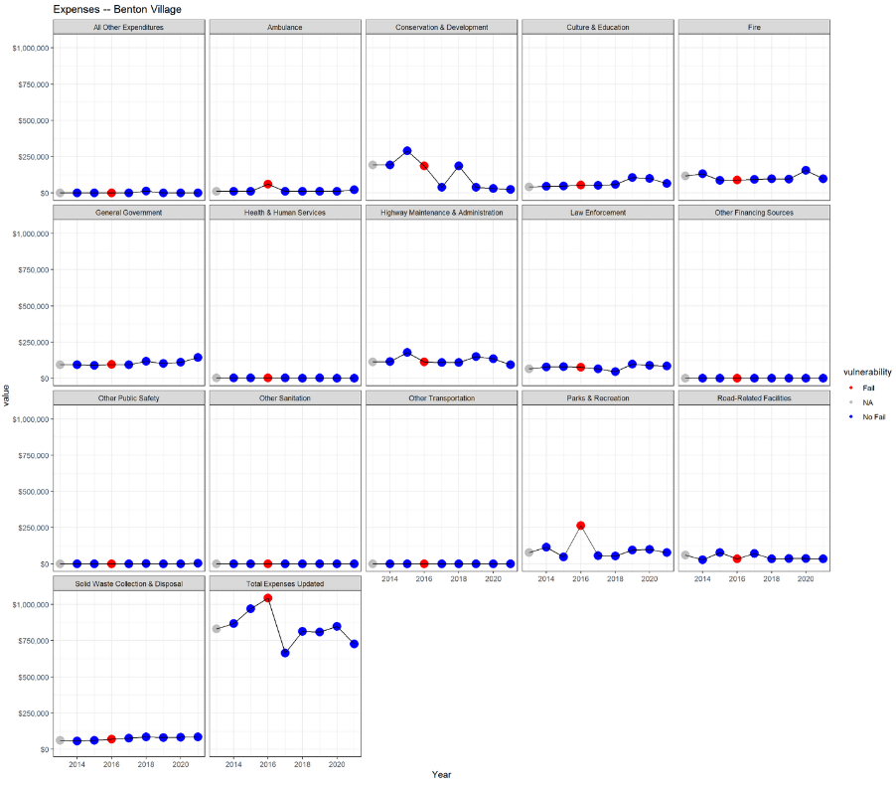

Slide 13

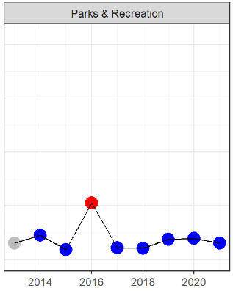
Example Cell for Expenses
Benton Village Parks & Recreation expenses.
Expense may be root cause of vulnerability in 2016.

Slide 14
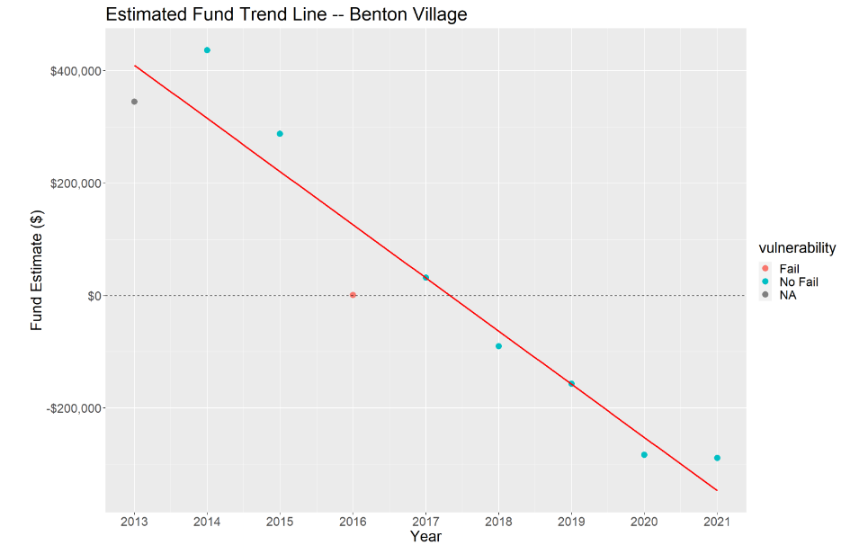
Individual Report- Trend Line
Trajectory of financial health for the municipality.
2013 starts with an estimated fund of 25% of 2013's expenses.
NOT a prediction model.

Slide 15
Standardized Profit
Want to compare the municipality's individual performance with the performance of the state and region.
Can help determine if a vulnerable year was affected to the financial situation of Wisconsin and Southwest Wisconsin.
Discrepancies in magnitude of profit cause issues.
Need a new metric to compare municipalities financial health.
Standardized profit is revenue subtracted by expenses divided by expenses.
Standardized profit = (revenue – expenses)/expenses

Slide 16
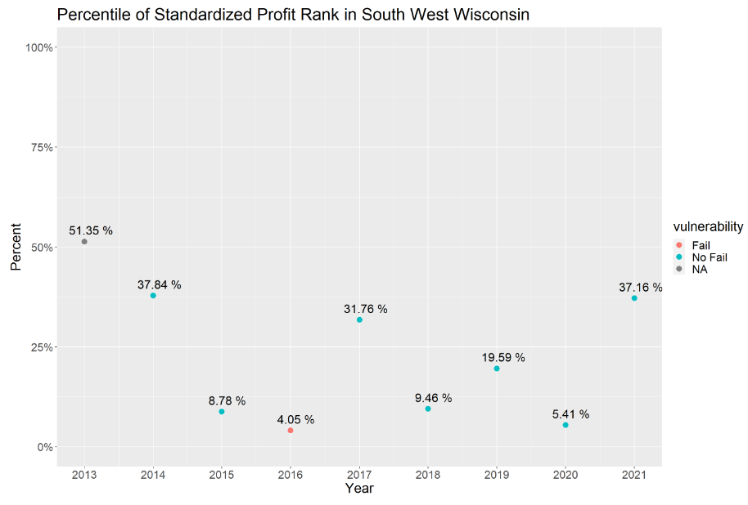
Individual Report- Southwest Wisconsin Rank Comparisons
Percentile represents percent of municipalities that performed worse in that year.
Compared to Southwest Wisconsin.

Slide 17
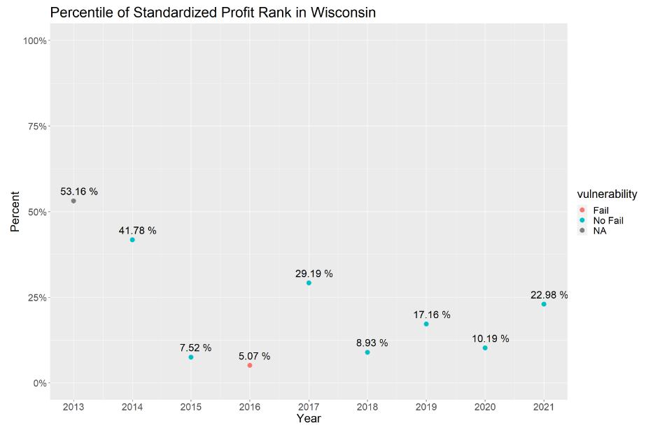
Individual Report- Wisconsin Rank Comparisons
Percentile represents percent of municipalities that performed worse in that year.
Compared to all of Wisconsin.

Slide 18
Predictive Analysis
Forecasting future fund estimates require more data and accurate fund estimates.
Predicting for vulnerability requires outside data sources to be explored further
Population and Municipality Type proved to have an insignificant effect on predicting vulnerability.

